Slide 1

What is Cloud Definition
Sameer zulfi

Slide 2
NIST Definition of Cloud

Slide 3
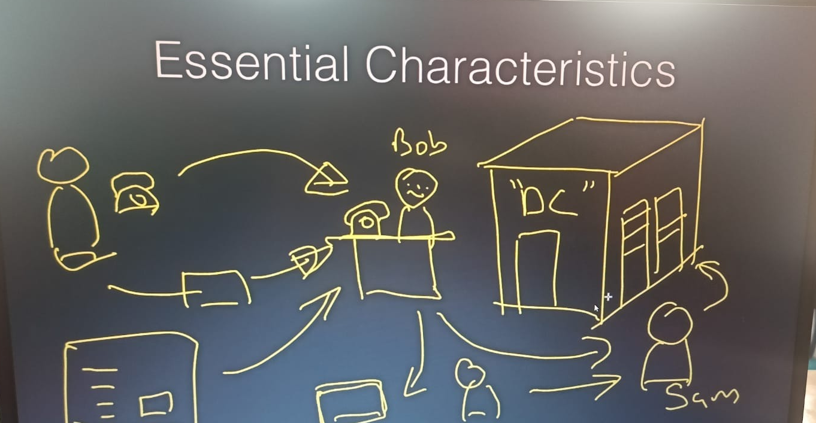
Traditional Self Service

Slide 4
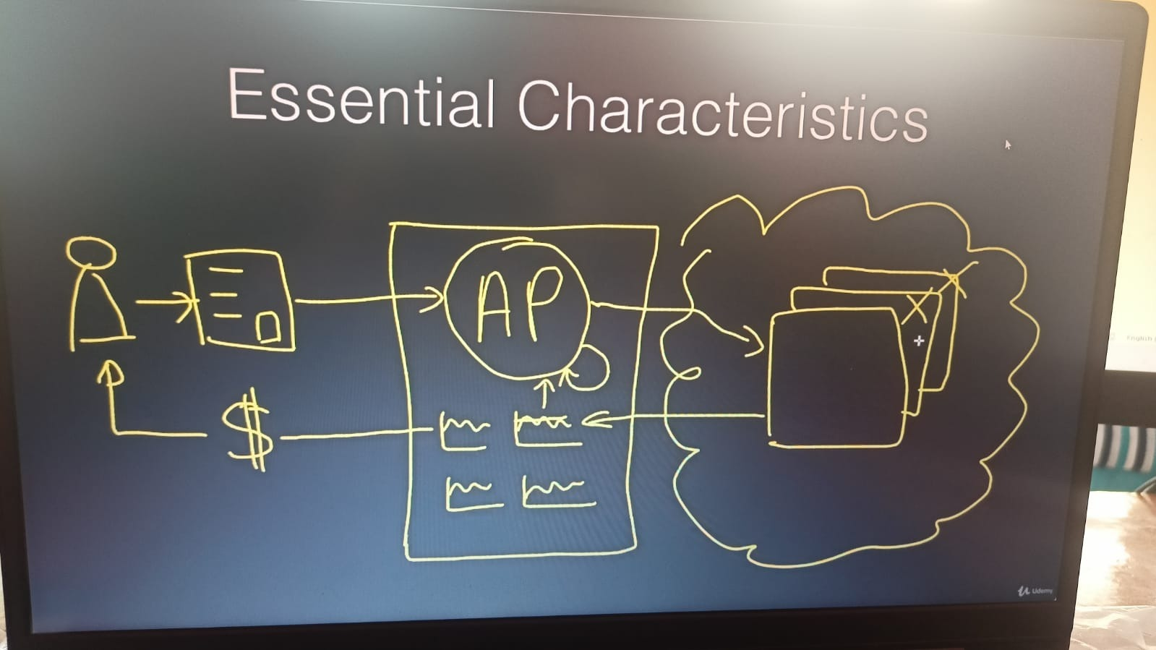
OnDemand Self Service

Slide 5
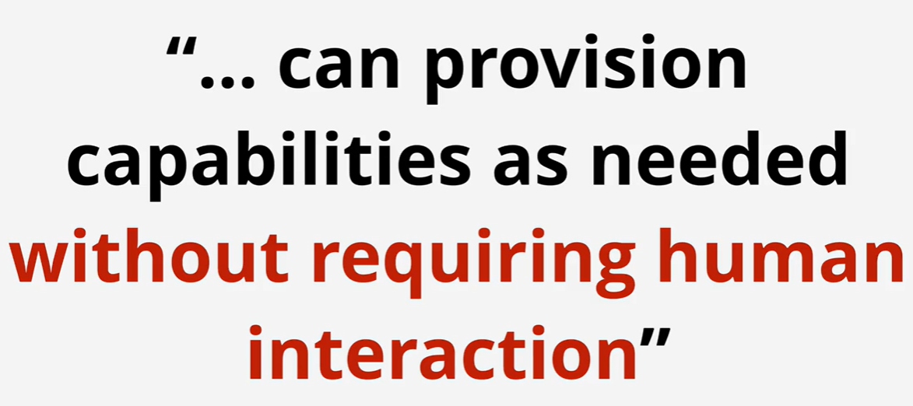

Slide 6
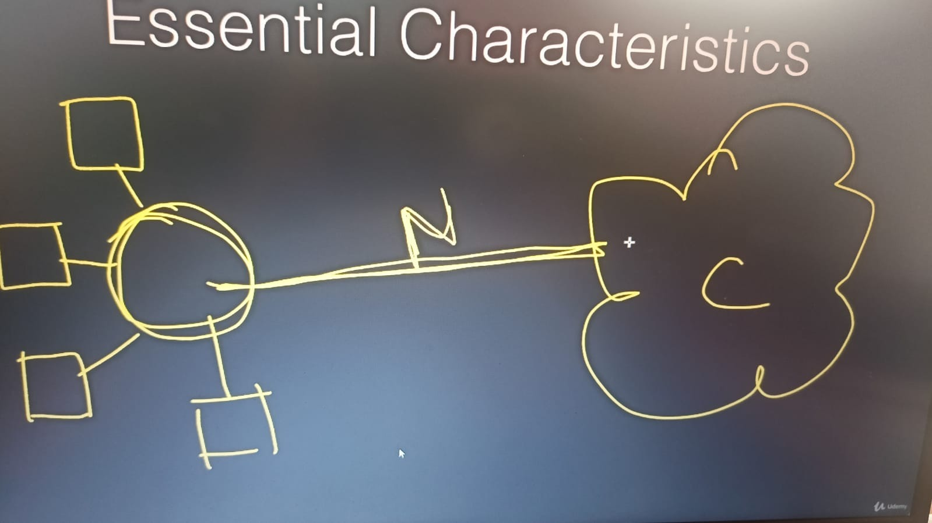
Broad Network Access

Slide 7
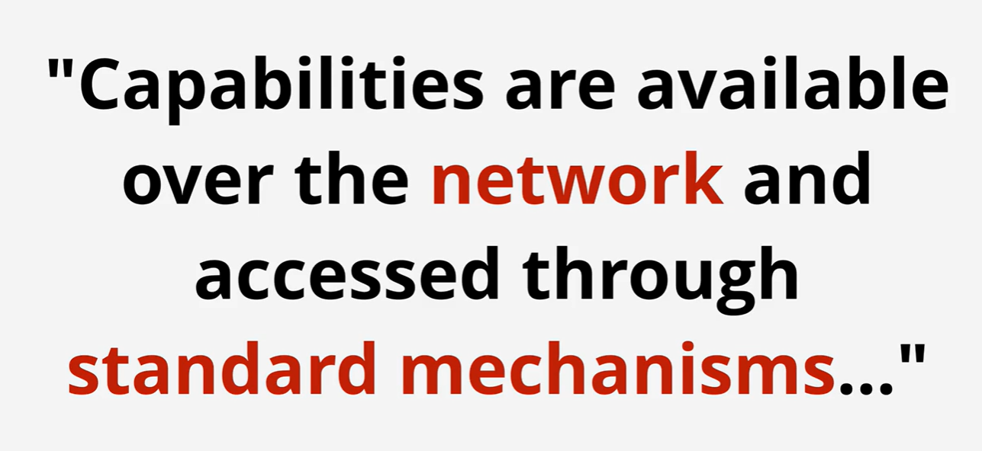

Slide 8
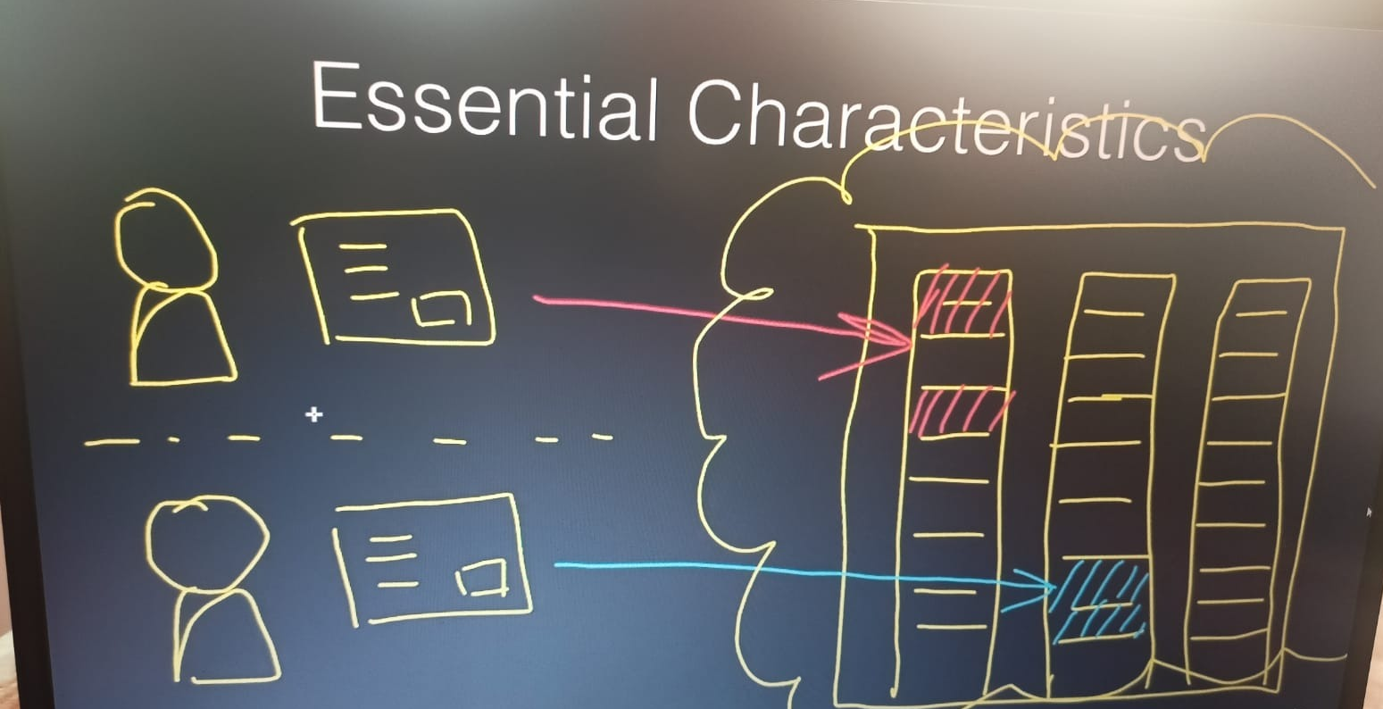
Resource Pooling

Slide 9
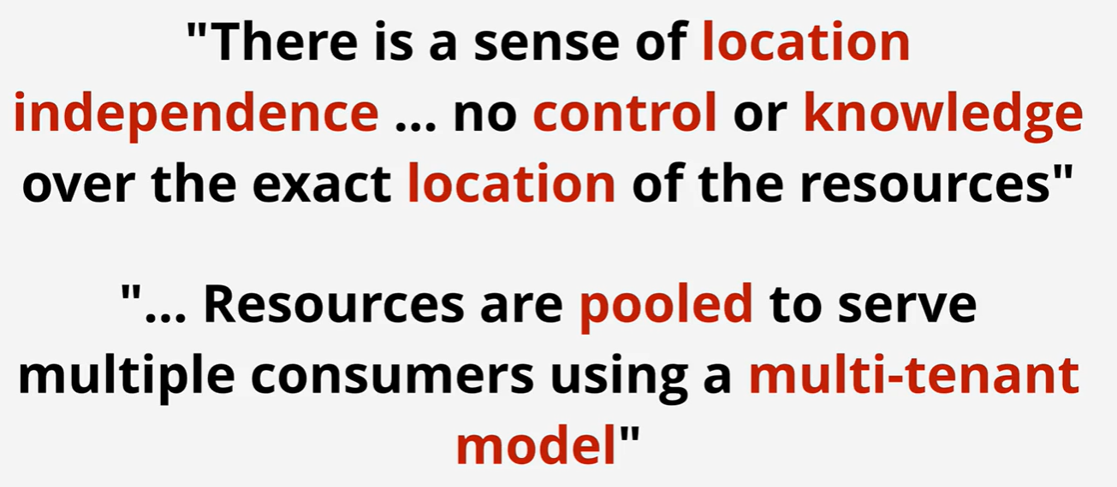

Slide 10
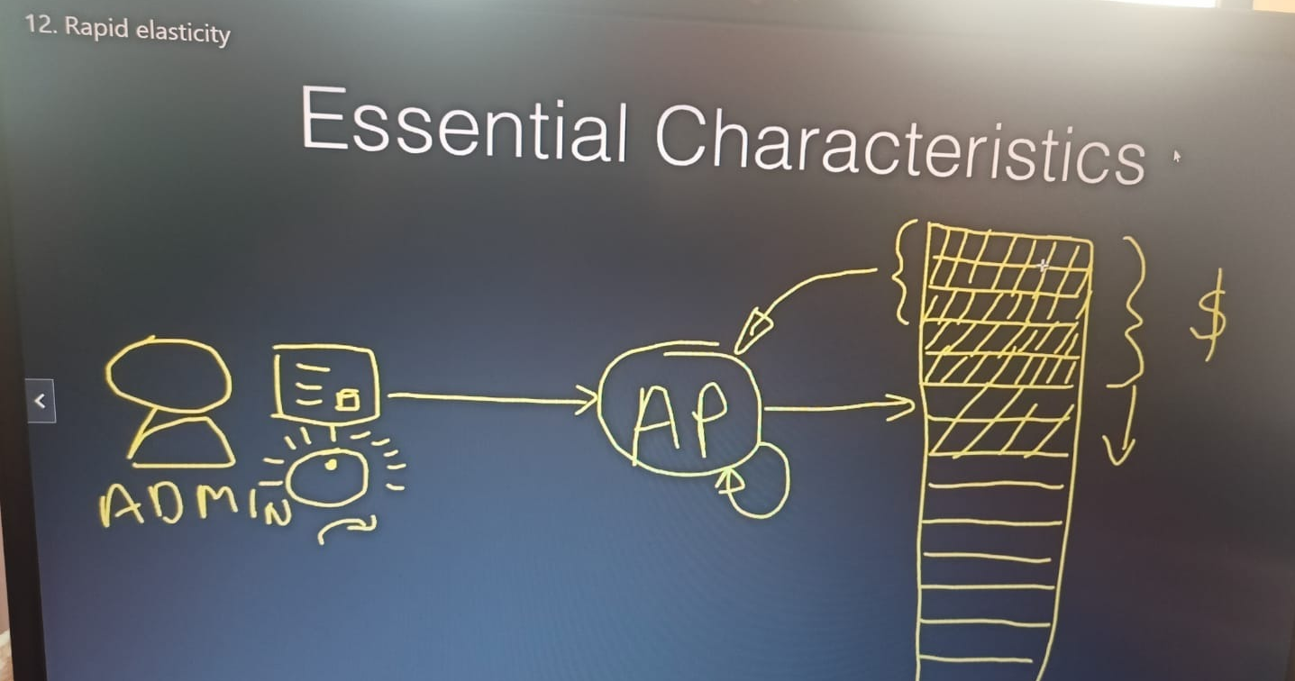
Rapid Elasticity

Slide 11
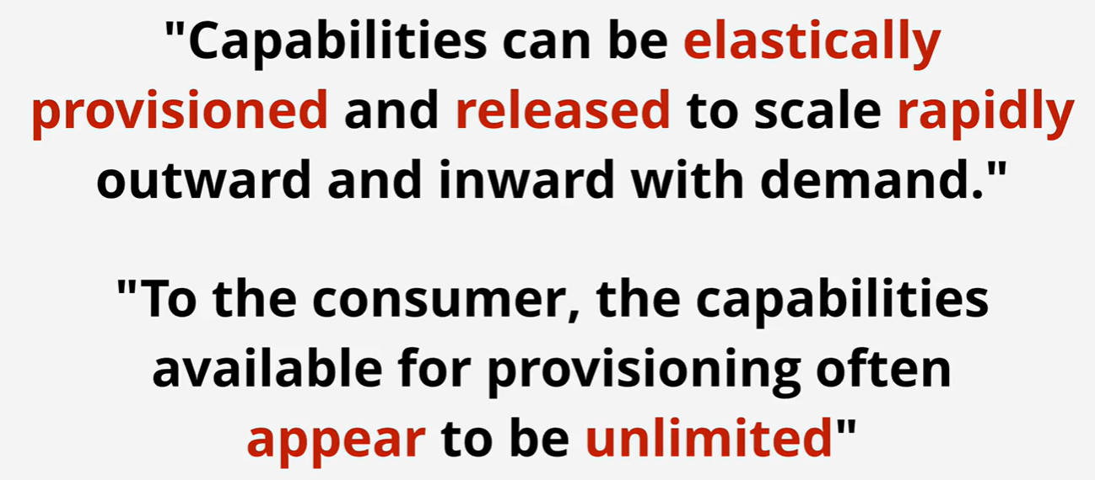

Slide 12
Measured Service

Slide 13
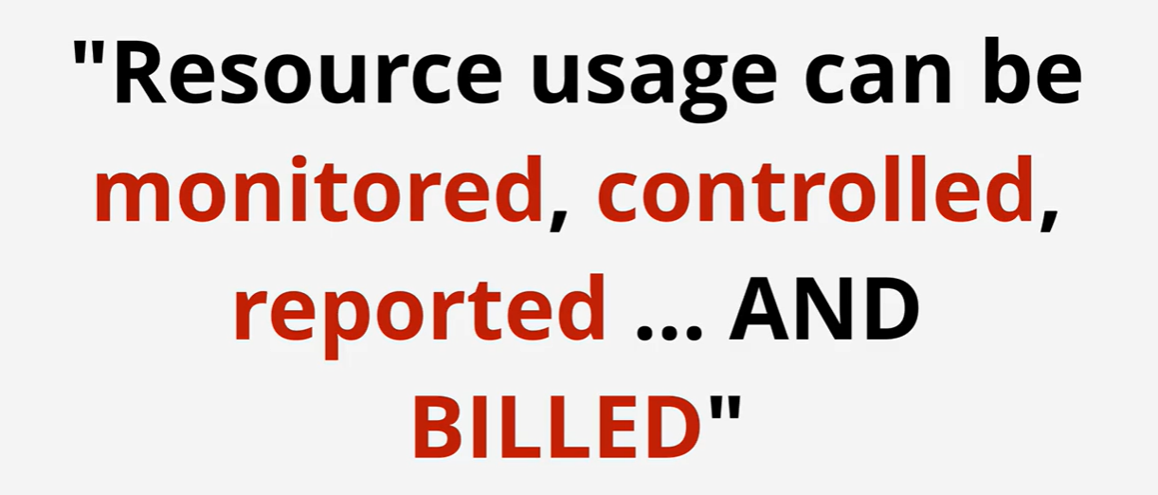

Slide 14
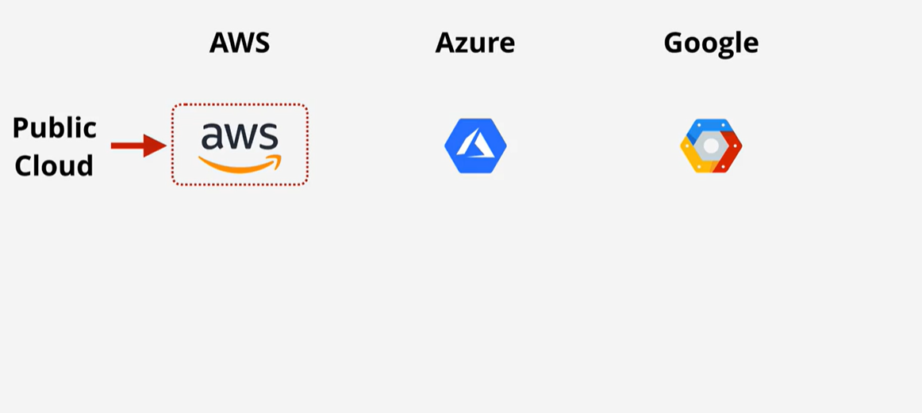
Public Cloud

Slide 15
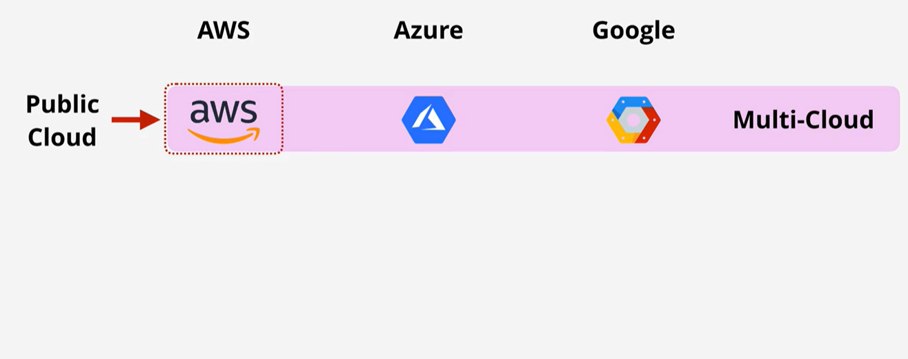
Multi Cloud

Slide 16
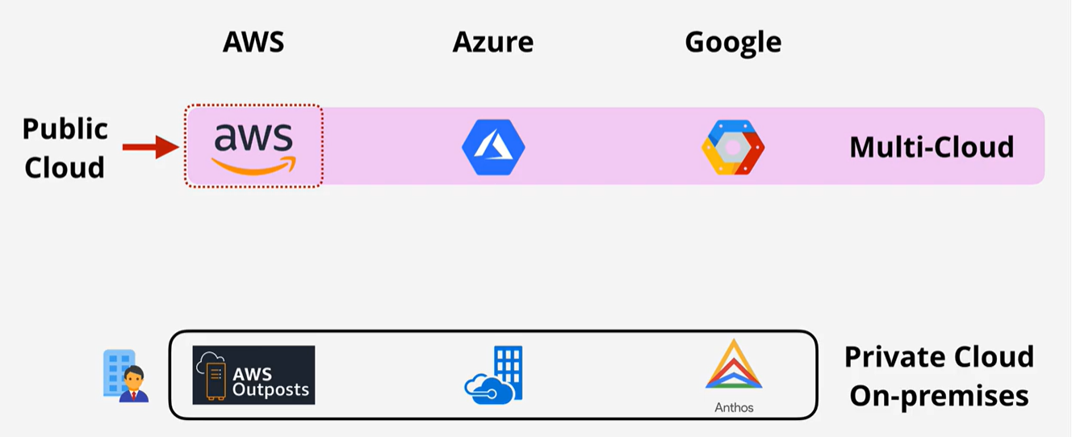
Private Cloud

Slide 17
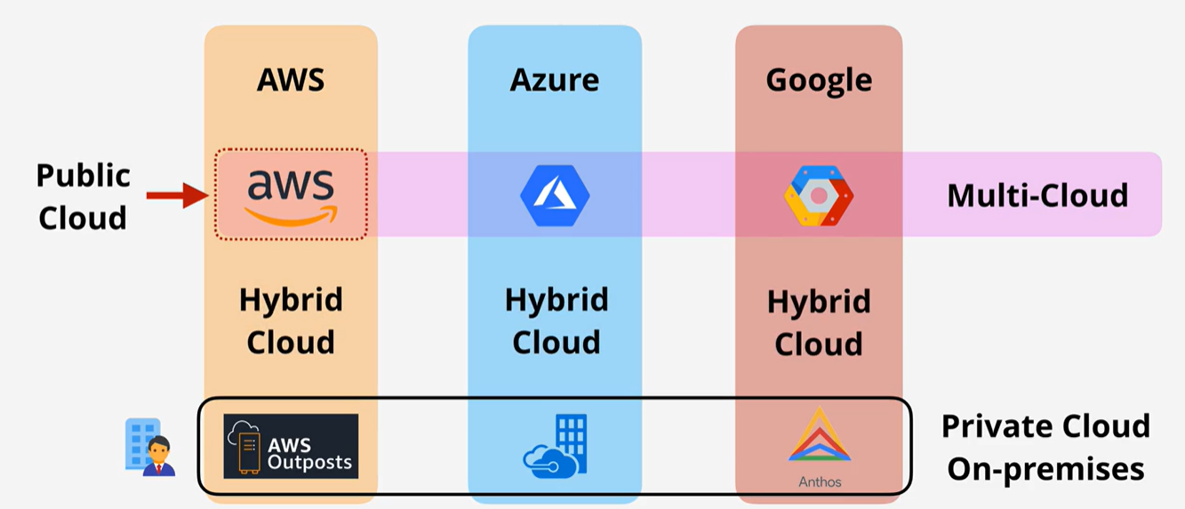
Hybrid cloud

Slide 18
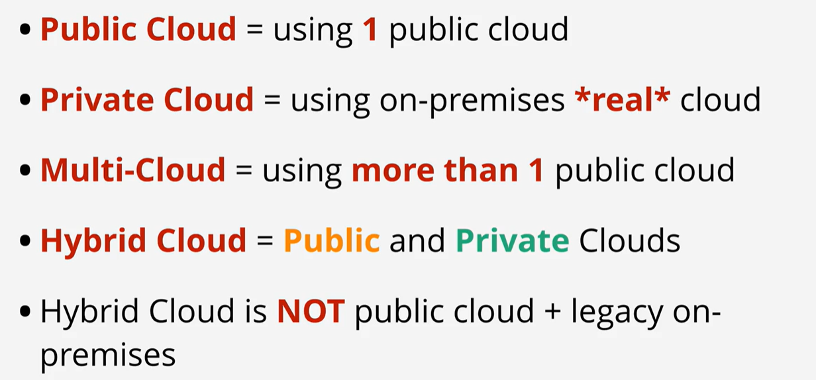
Public vs Private vs Multi vs Hybrid

Slide 19
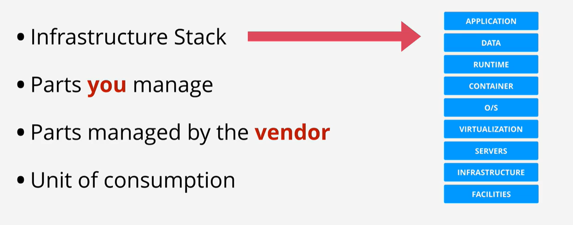
Terms & Concepts

Slide 20
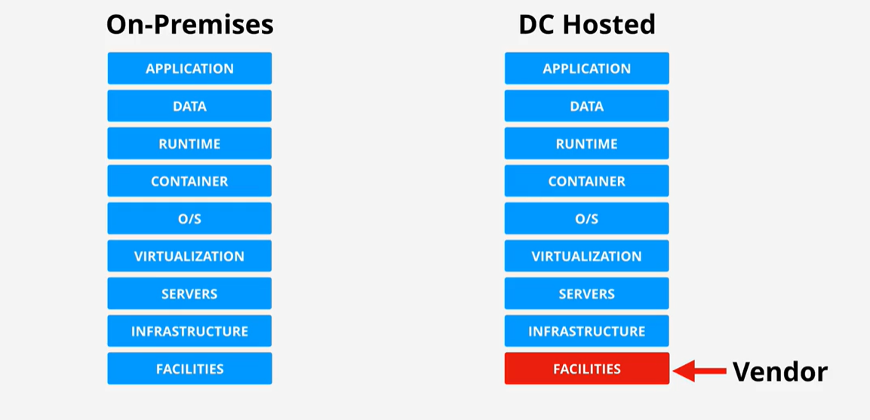
On-Premises vs DC Hosted

Slide 21
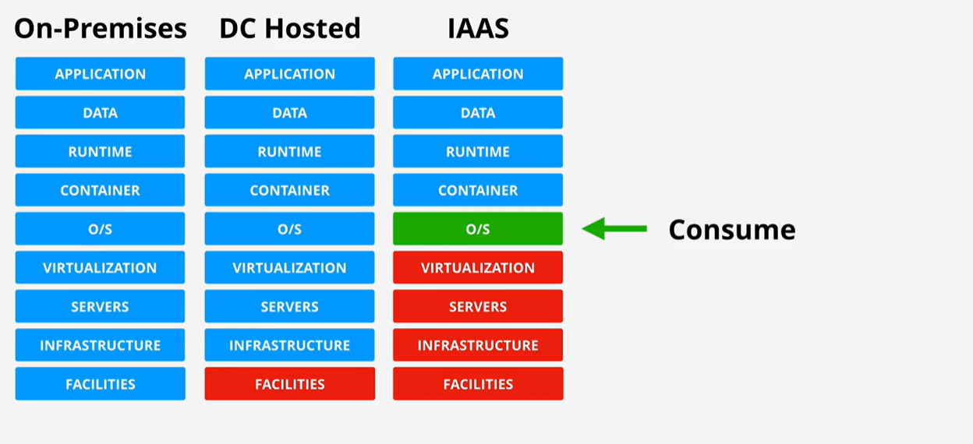
IaaS – Infrastructure as a Service

Slide 22
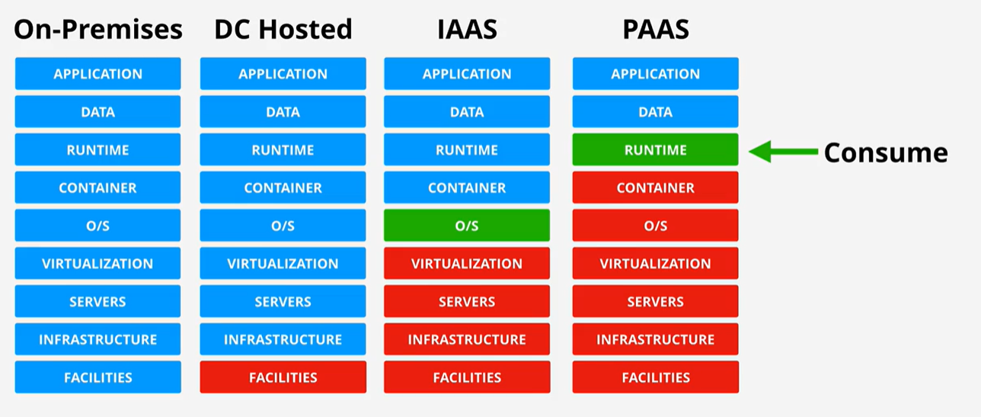
PaaS – Platform as a Service

Slide 23
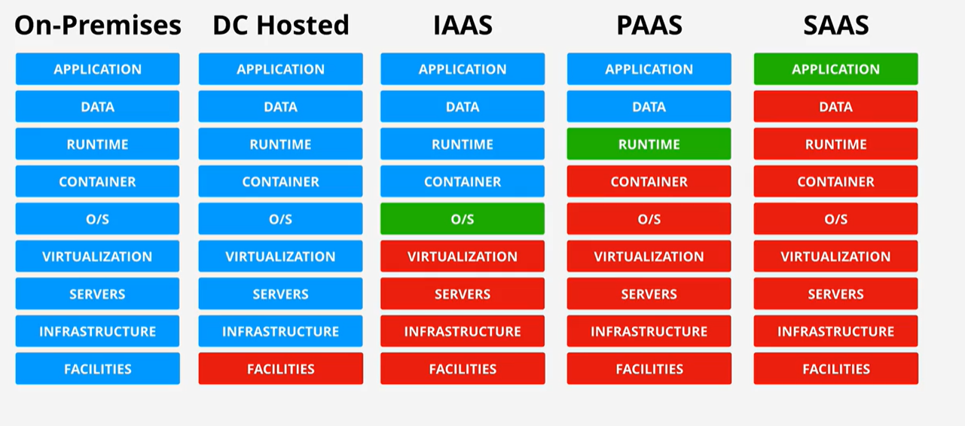
SaaS – Software as a Service

